Slide 1



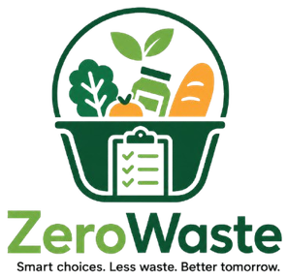





ZeroWaste Presentation
www.zerowaste.com

Slide 2



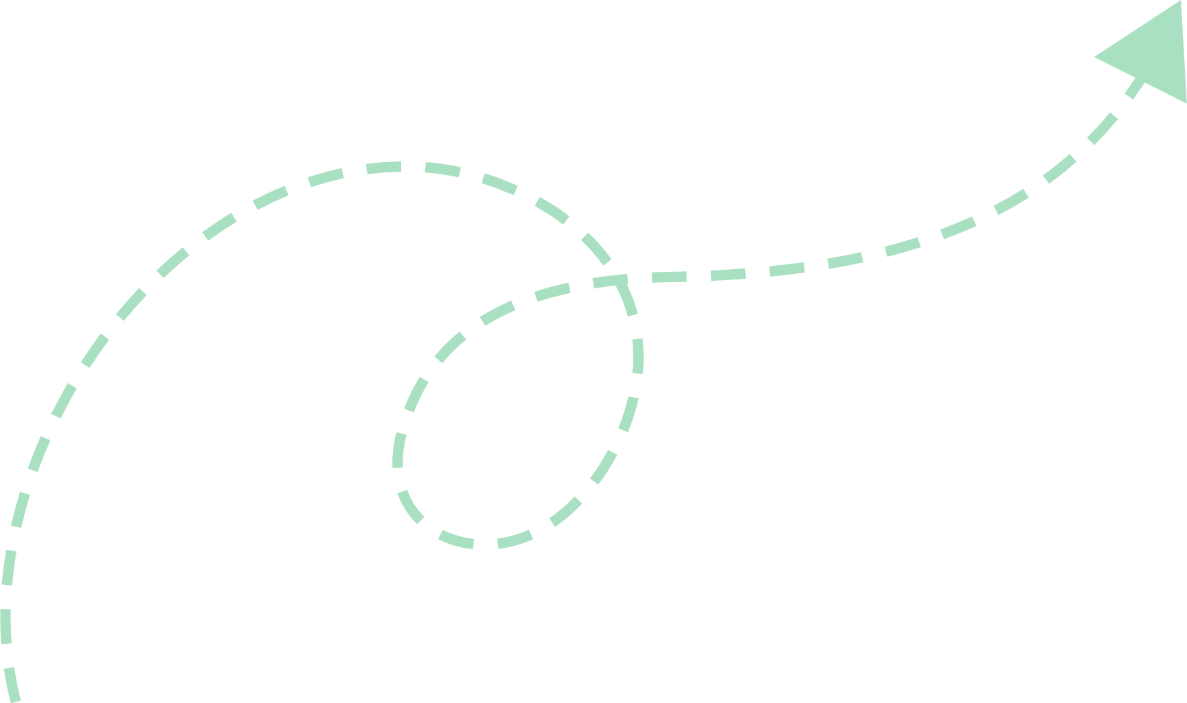
ZeroWaste
A Smart Food Waste Management and Household Food Management
Presented By
Saksham Sharma Sedhai(E2300573) –Developer and Tester

Slide 3

Agenda
Introduction
Test Plan & Test Cases
Problem and Solution Recap
Git Collaboration
Aim & Objectives - Iteration 1
Project Progress
Iteration 1 - Scope (Use Cases)
Gantt Chart
System Architecture
Conclusion & Next Steps
Working Prototype Walkthrough

Slide 4
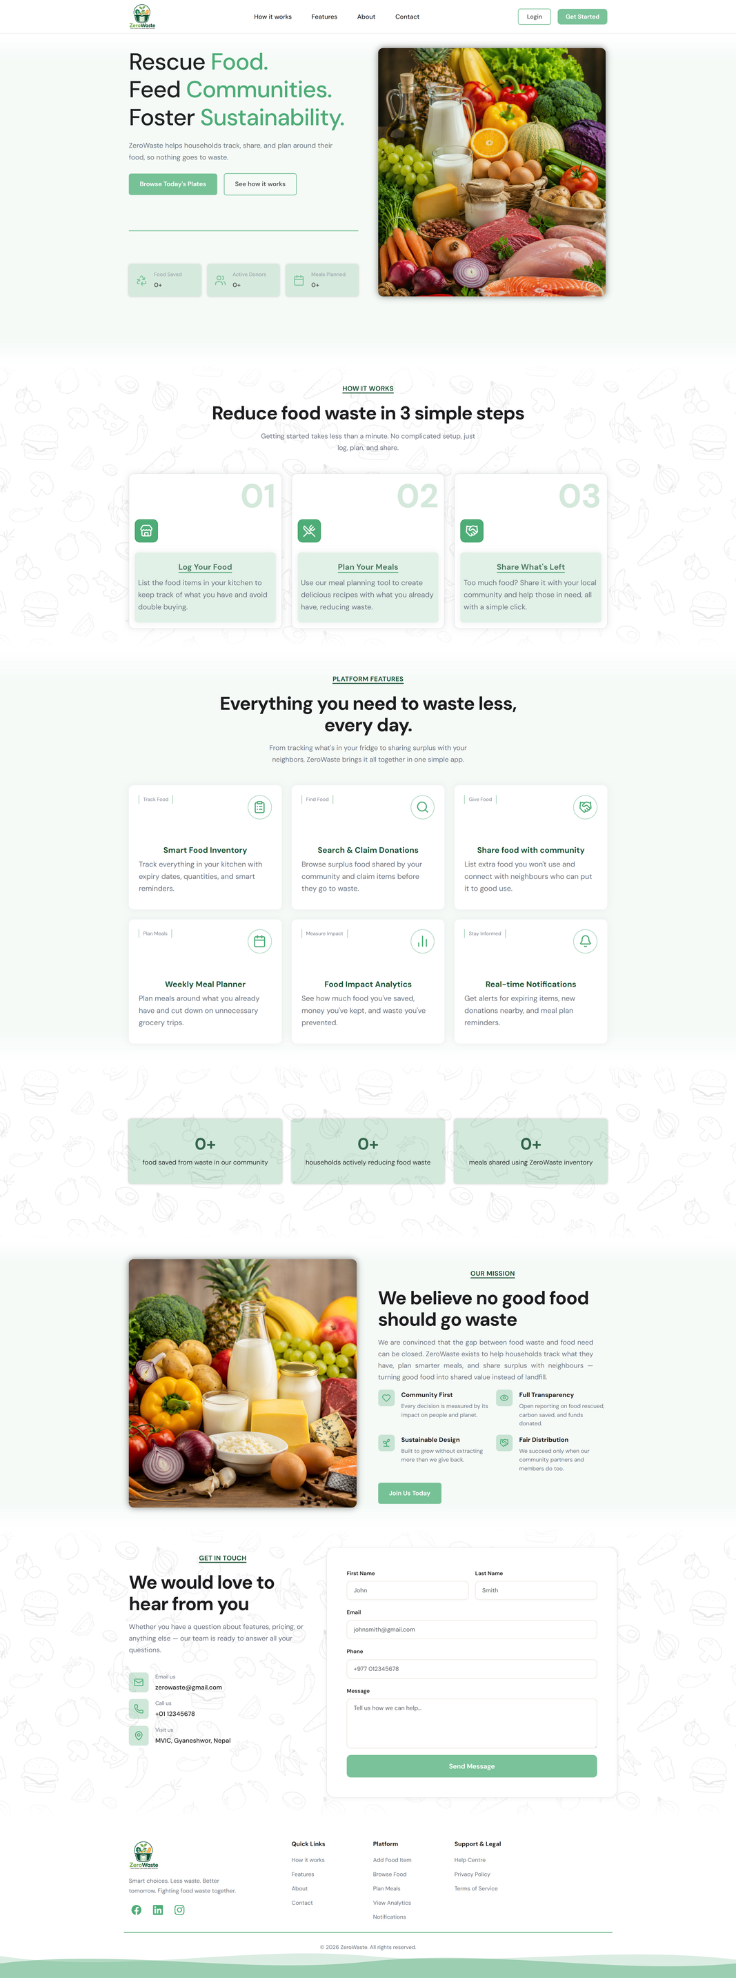
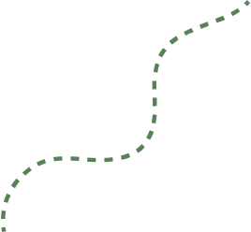
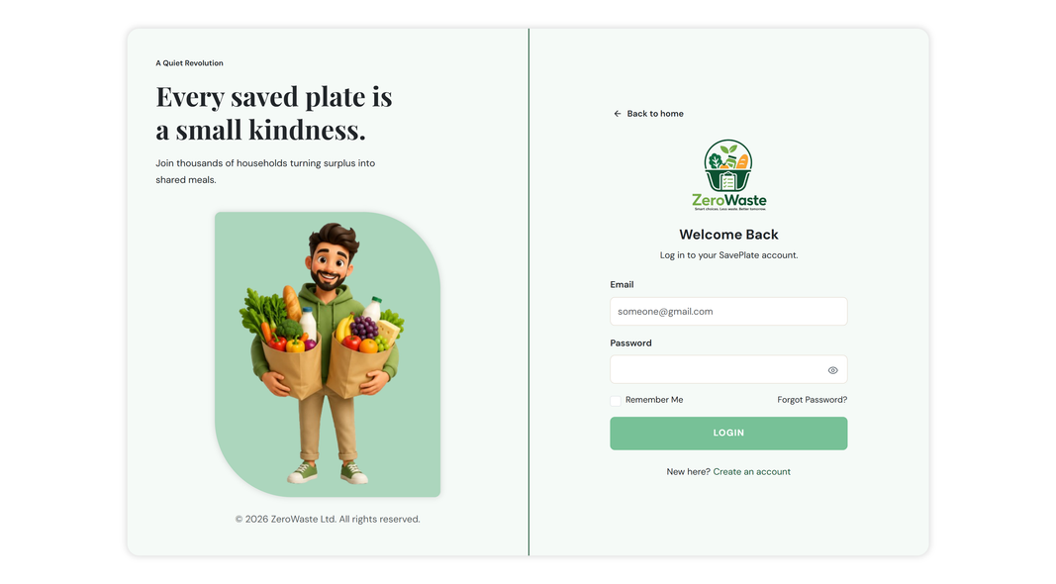
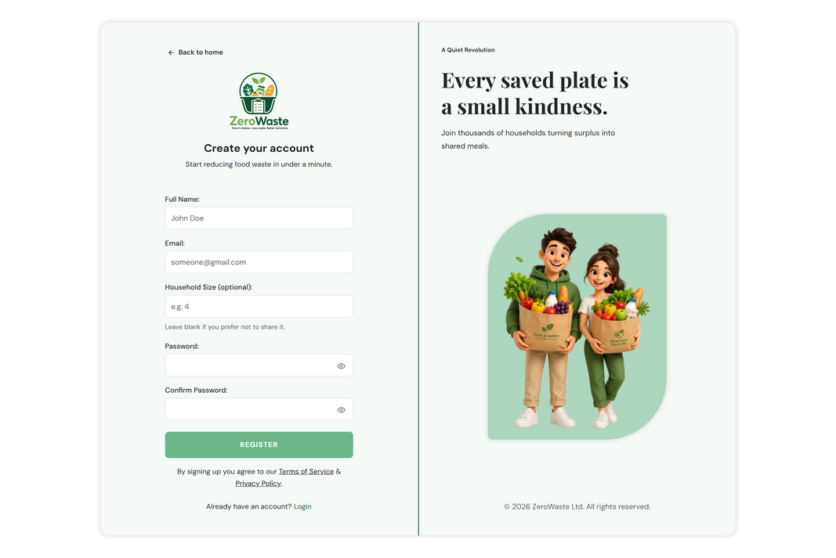
ZeroWaste
A web-based food waste management and household food inventory system designed to address the growing issue of food wastage among households.
The proposed system aims to assist users in managing food inventories efficiently through features such as expiry-date tracking, real-time notifications, food donation facilitation, food analytics, and weekly meal planning.

Slide 5


Problem & Solution Recap
The problem
High household food waste inn Malaysia.
No effective food inventory and expiry tracking.
Limited platform for surplus food donation.
Inefficient meal planning increases food waste.
Privacy and security concerns reduce user trust.

Slide 6

Problem & Solution Recap
The solution
Smart Food Inventory Management
Expiry Tracking and Notifications
Community Food Donation
Recipe Suggestion Based Meal Planning
Secure Registration with 2FA

Slide 7

Aim & Objectives
The aim
Reduce household food waste in Malaysia.
Encourage efficient food inventory management.
Support community-based food donation.
Optimize food usage with meal planning and expiry tracking.
Minimize waste through smart reminders and notifications.

Slide 8



Aim & Objectives
The objective
Secure user registration (2FA)
Food Inventory Management System
Expiry date tracking system
Food donation module
Real-time notifications
Food analytics dashboards
Weekly meal planner
Ensure high performance, security and usability
User-friendly hierarchical navigation

Slide 9











Scope
Meal Reminders
Expiry Alerts
Weekly Meal Planner
Food Analytics Dashboard
Food Donation & Claim System
Settings
Food Inventory Management
User Registration & 2FA
Real Time Notifications

Slide 10












Scope in this iteration
Register Users & Privacy Settings
01
Users register and control privacy/security settings (2FA, listing visibility) anytime from the dashboard.
Manage Food Inventory
02
Users track food items with expiry, quantity, and category, then edit, use, or convert them into donation listings or meal plans.
Browse Food Items
03
Users browse food listings by location or type, view item and pickup details, and claim donations with confirmation notifications.

Slide 11



System Architecture
Frontend
React.js
Component based UI
Client-side form validation
state management (hooks/context)
Backend
Spring Java
RESTful APIs
Business Logic and Auth (2FA)
Layered service/controller design
Database
PostgreSQL
Relational Schema
Users, inventory, listings, notifications
Data integrity via constraints

Slide 12
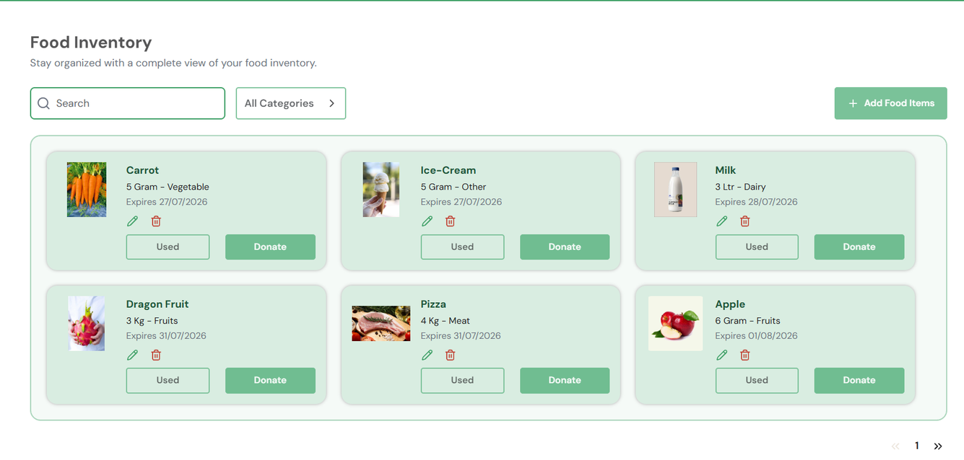
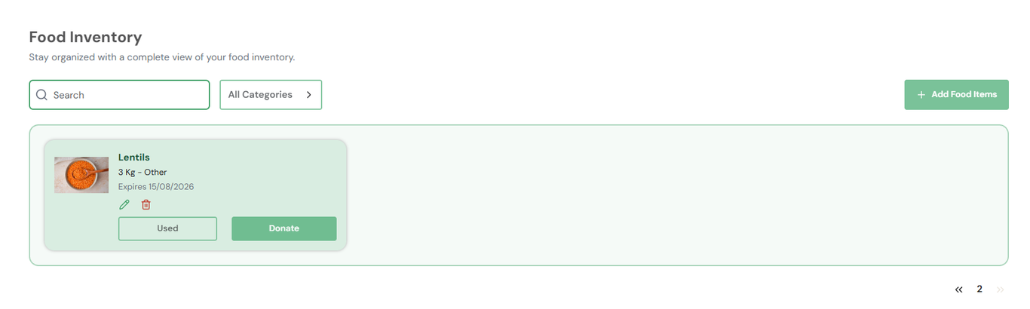
Working Prototype
Pagination 01
https://www.youtube.com/watch?v=X830Vtpmzl4
Pagination 02

Slide 13
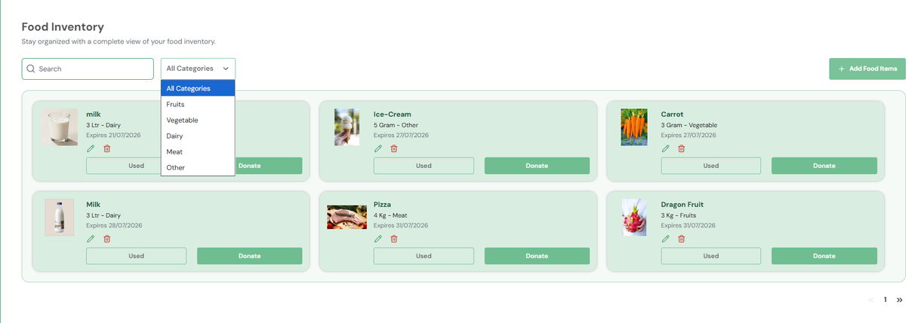
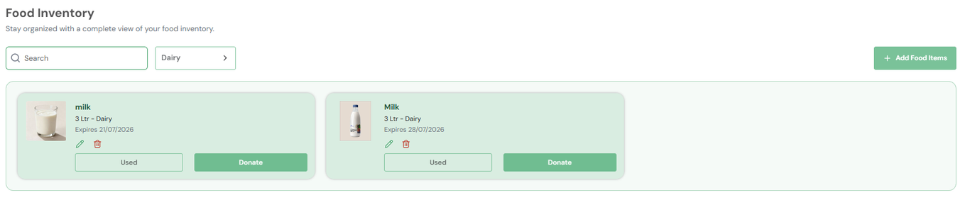
Working Prototype
All Category
Filtered Category

Slide 14
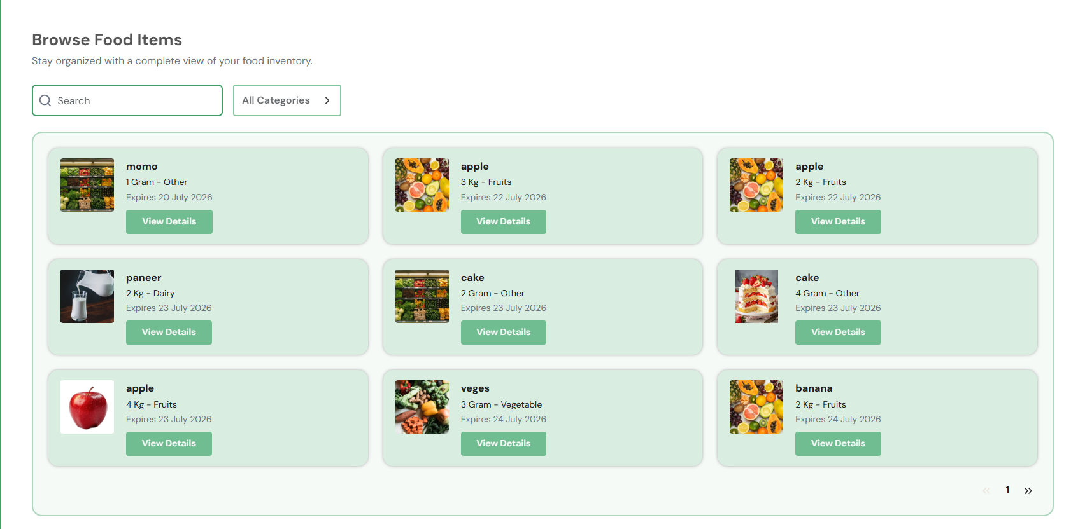
Working Prototype-03
Listed all browse items

Slide 15
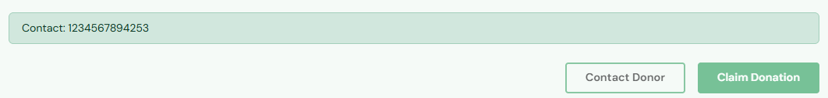
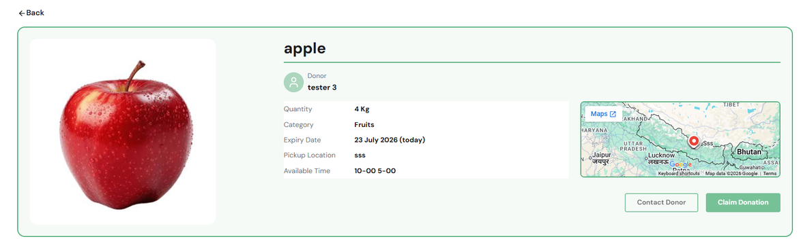
Working Prototype
Contact Donor
View Donor Details

Slide 16
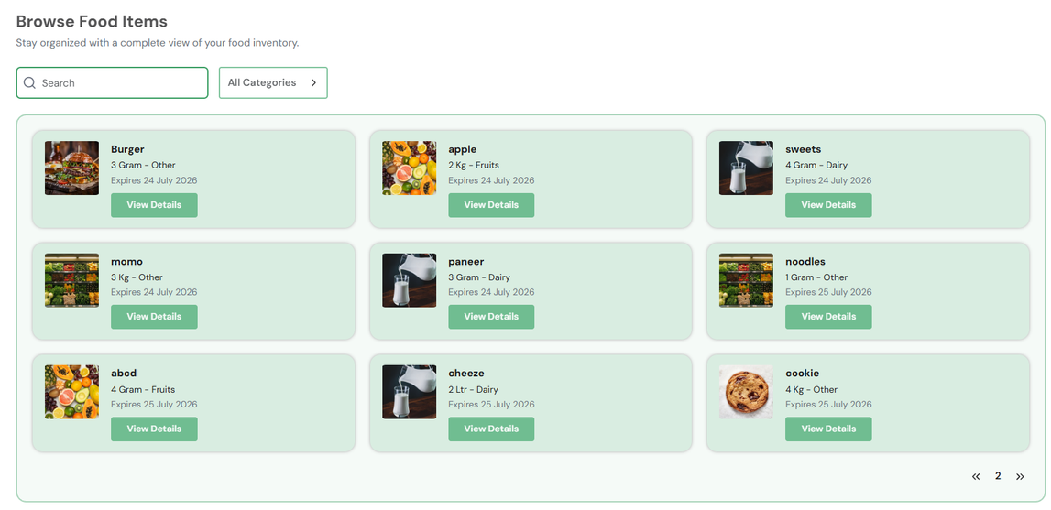
Working Prototype
Pagination 01
Pagniation 02

Slide 17
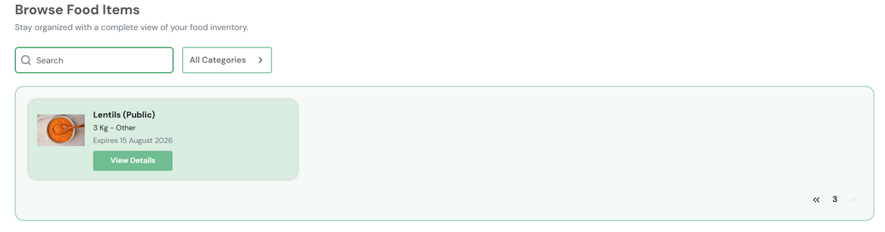
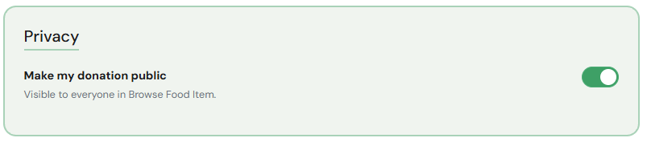
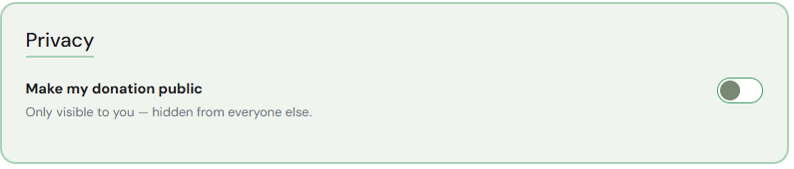
Working Prototype
Own Browse Food Item
Private Visibility
Enable Public Visibility

Slide 18
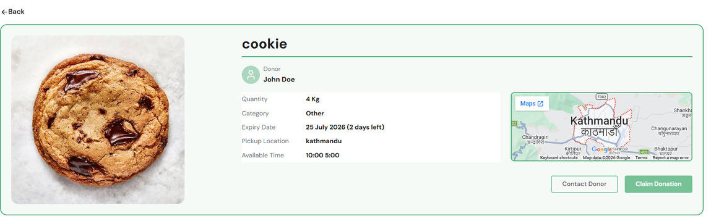
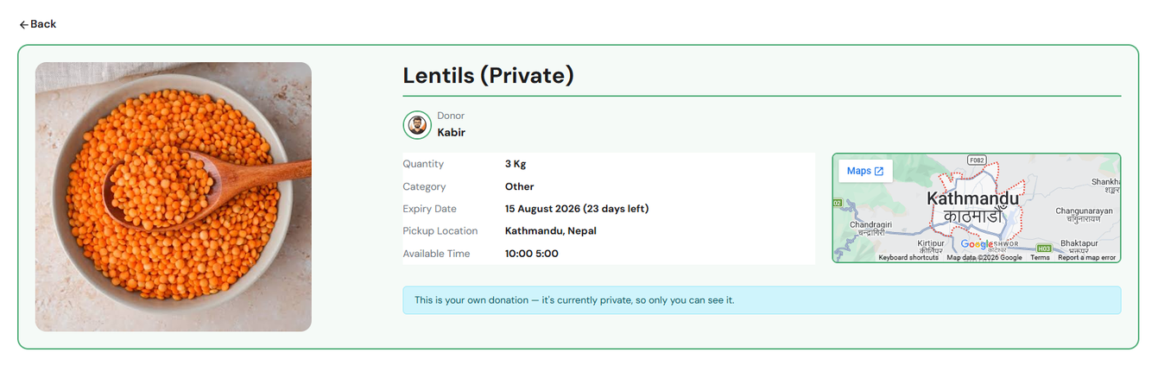
Working Prototype
Other donor item
Own browse food item

Slide 19
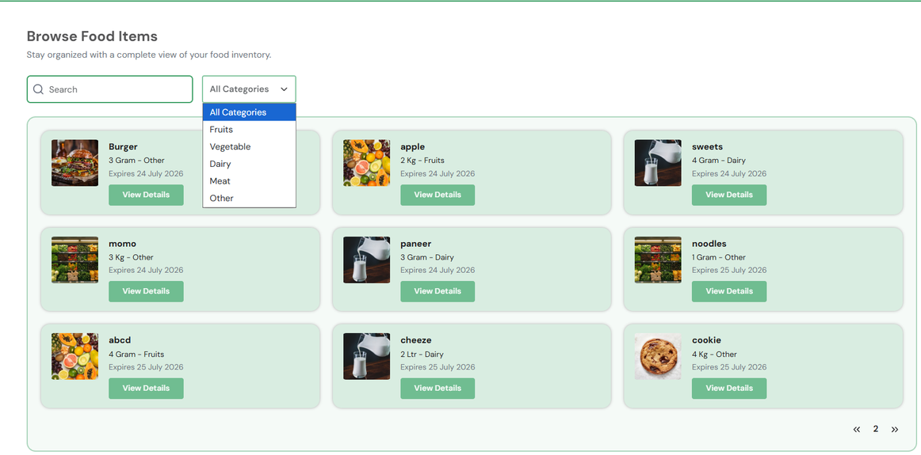
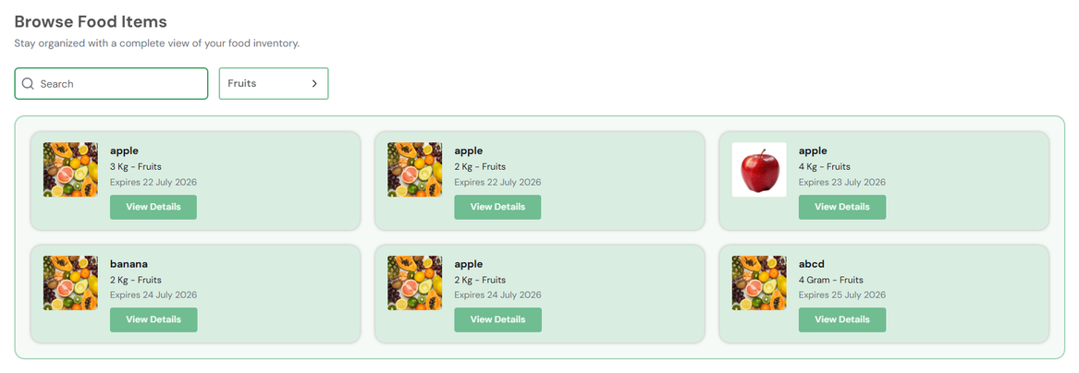
Working Prototype
All Category
Filtered Category

Slide 20
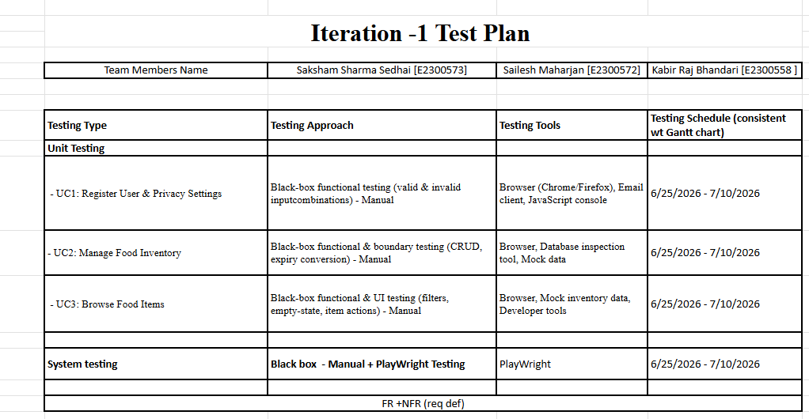
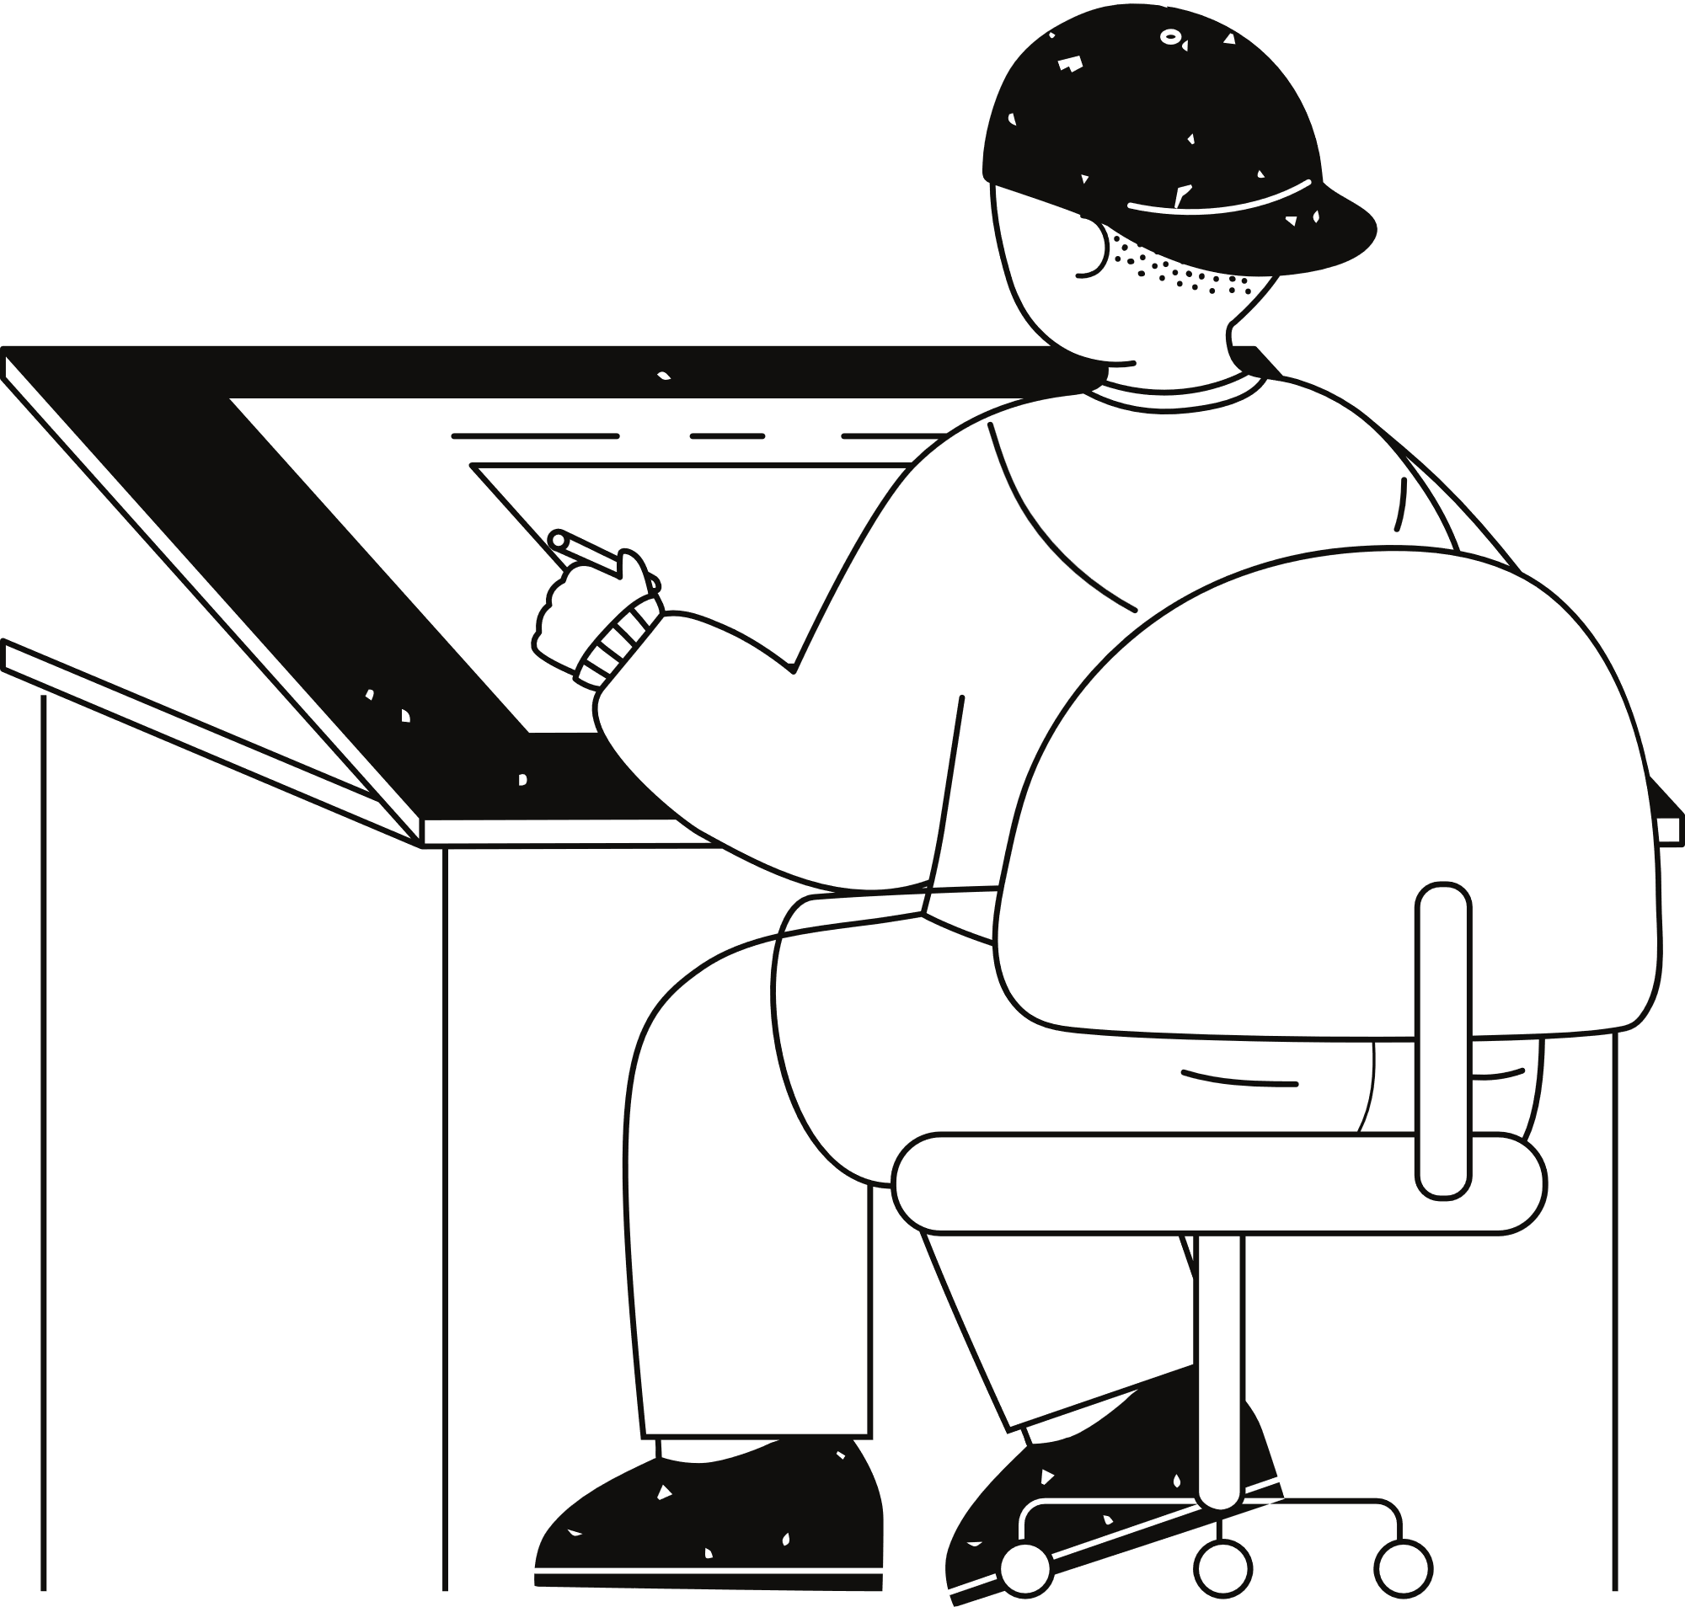
Test Plan

Slide 21
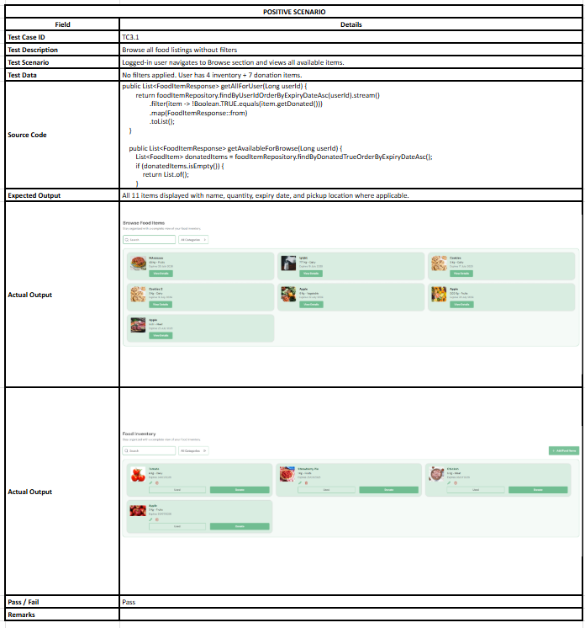
Test Cases

Slide 22


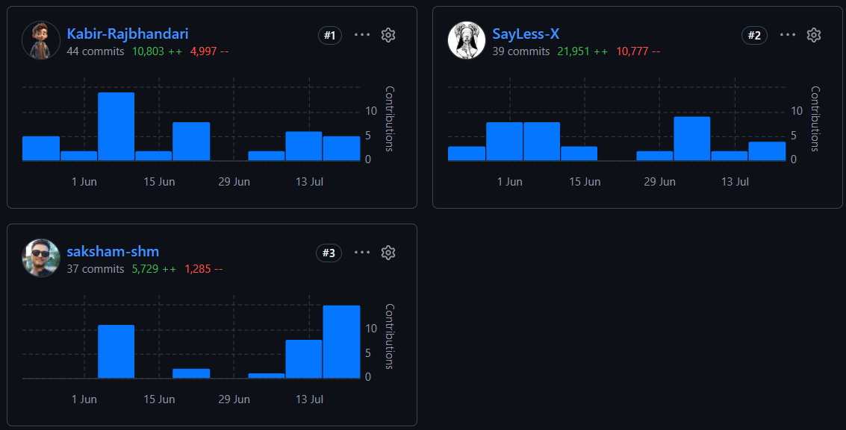
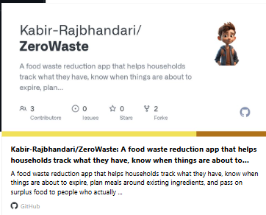

Git Collaboration
https://github.com/Kabir-Rajbhandari/ZeroWastehttps://github.com/Kabir-Rajbhandari/ZeroWaste

Slide 23

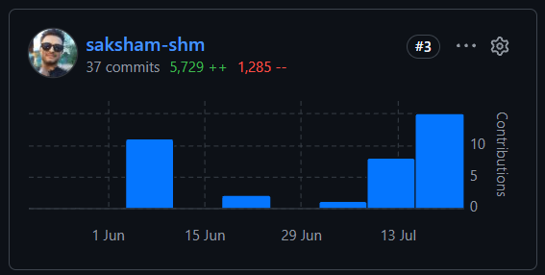
Git Collaboration
Saksham Sharma Sedhai
Developer
Doc Writer
Team Member

Slide 24

Project Progress
Milestones | Status
UC 1 - Development and Testing | Completed
UC 2 - Development and Testing | Completed
UC 3 - Development and Testing | Completed
Iteration 1 - Deliverables | Completed
UC 4 - Development and Testing | In Progress
UC 5 - Development and Testing | In Progress
UC 6 - Development and Testing | In Progress
Iteration 2 - Deliverables | In Progress

Slide 25

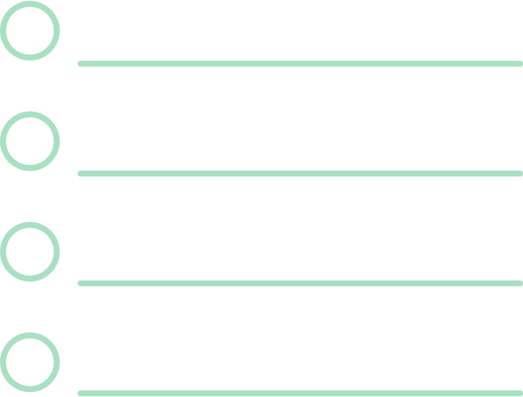
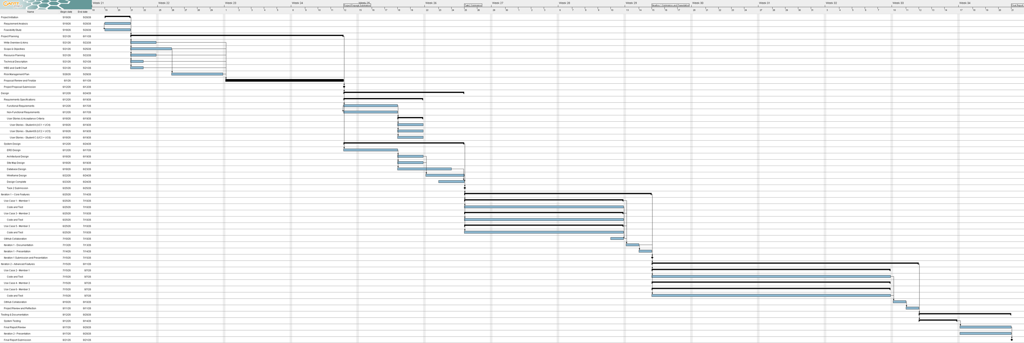
Gantt Chart

Slide 26

Conclusion
Iteration 1 successfully delivered SavePlate's core registration, inventory, and donation-browsing features, validated through structured testing and a disciplined Git workflow, while staying on schedule. Iteration 2 will extend this foundation with analytics, notifications, and meal planning.

Slide 27
Links
https://www.youtube.com/watch?v=X830Vtpmzl4
https://github.com/Kabir-Rajbhandari/ZeroWaste

Slide 28
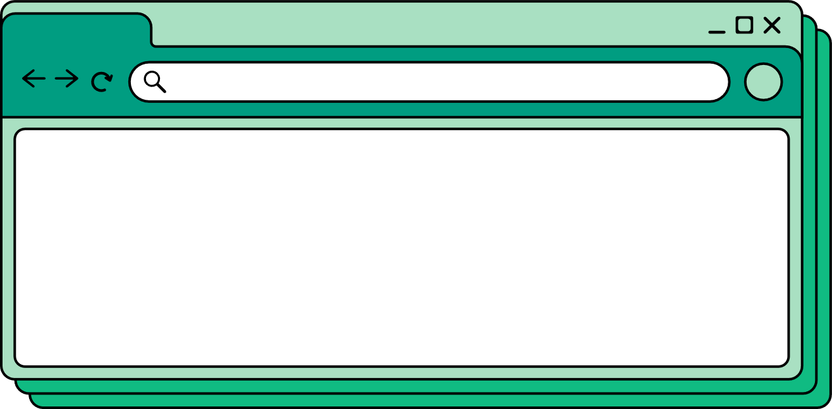

zerowaste
Thank You!
page 015
www.reallygreatsite.com

